Slide 1

Rossmann Store Sales
Notes:
Rossmann Stores : 1115 2,5 Years observation for Sales, Customers, Competition, Promotions

Slide 2
Dataset
1511 Stores
Daily sales data for 2,5 years
Competitior distance
StoreType
Promotion

Slide 3
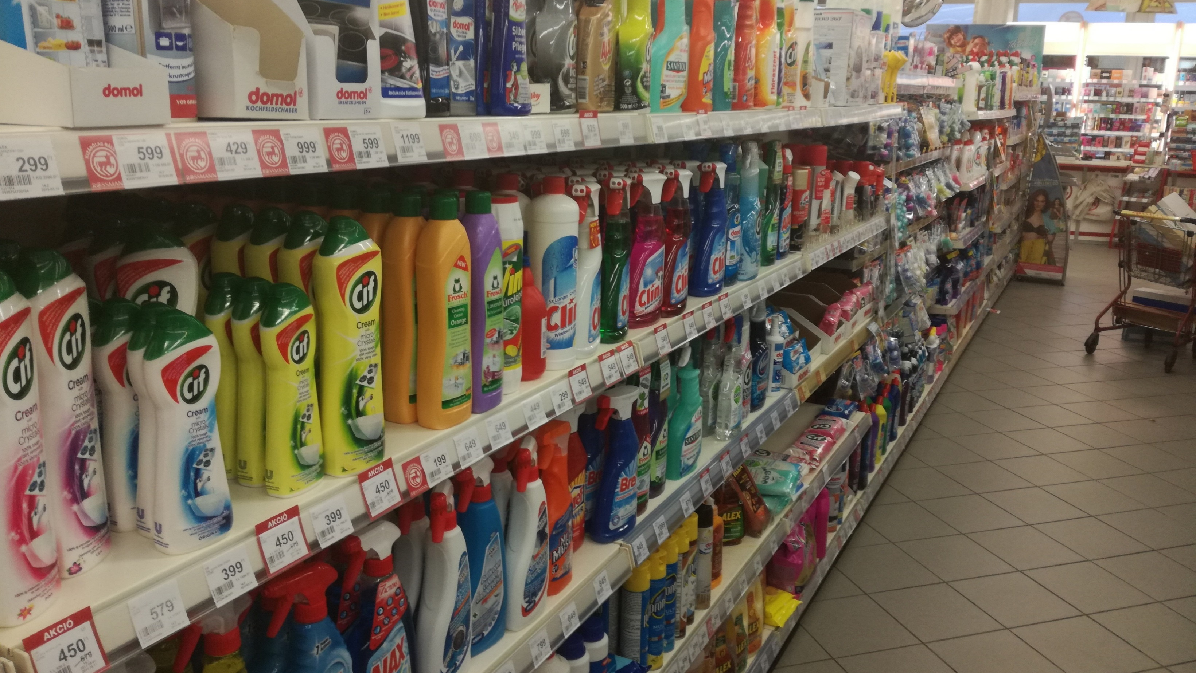
So I went to Rossmann

Slide 4
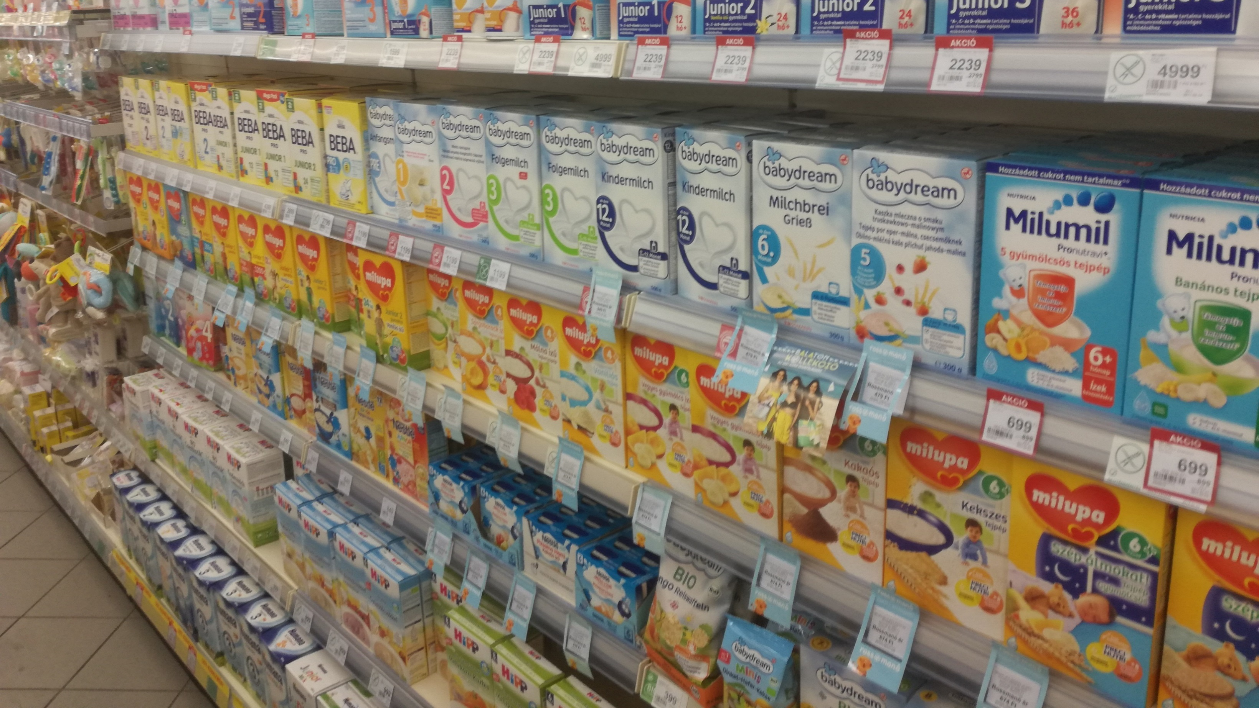
To see what you can buy

Slide 5
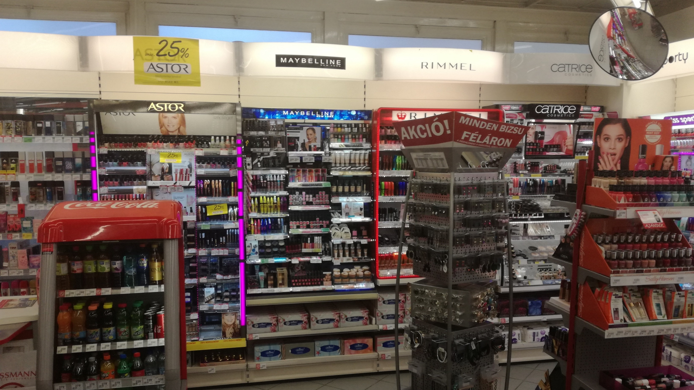
Well, lots of different things

Slide 6
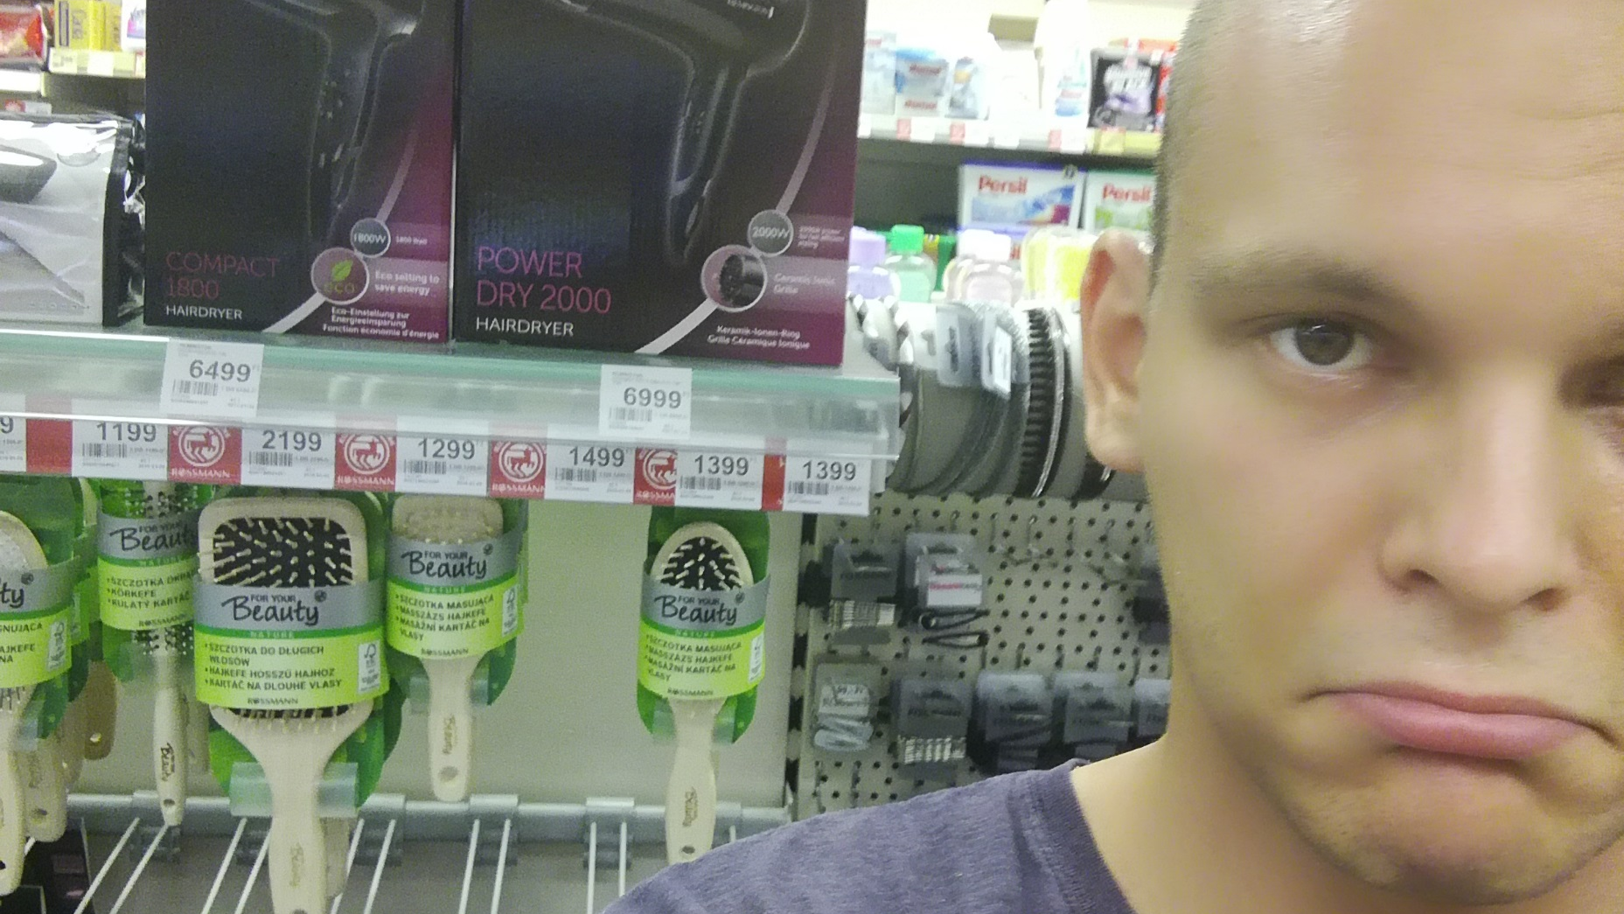
But it is not for everyone

Slide 7
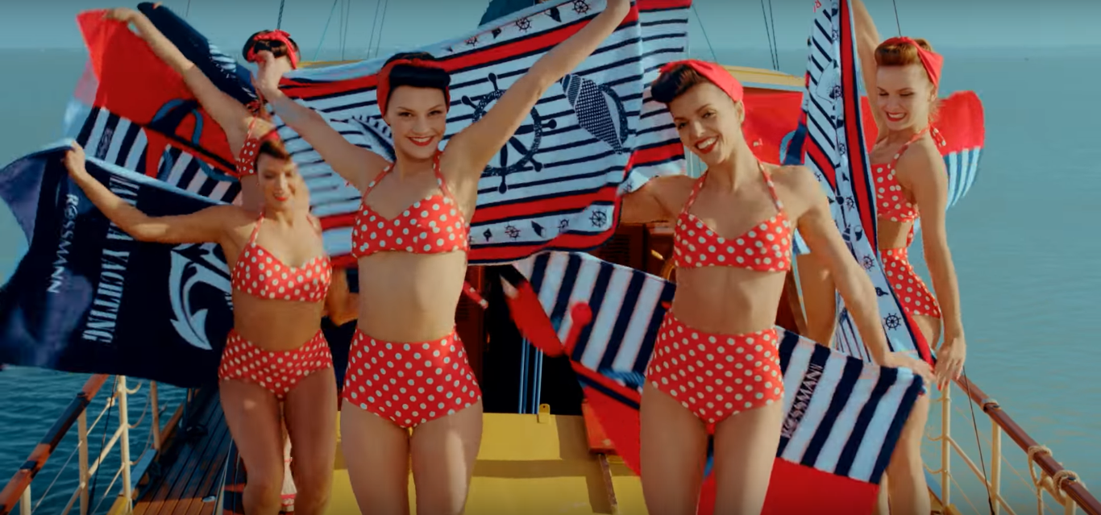
What are we interested in?
Basket size
Competition
Customers
Promotion
StoreType

Slide 8
What are we interested in?
KPIs
Strategy
Market

Slide 9
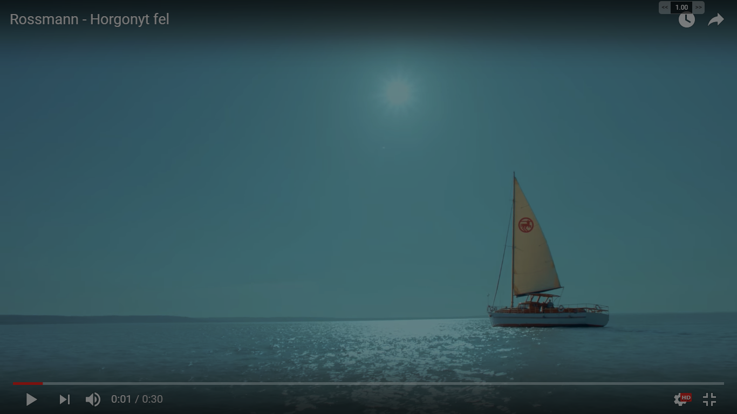
Conclusions
Store type b is a different animal
Responds to Competition, Seasonality and Promotion in a different way and has different KPIs
Sunday opening is worth it for some stores only: Plaza stores with minimal competition
Regular promotion increases basket size for d an a, but reduces it for c
StoreType

Slide 10
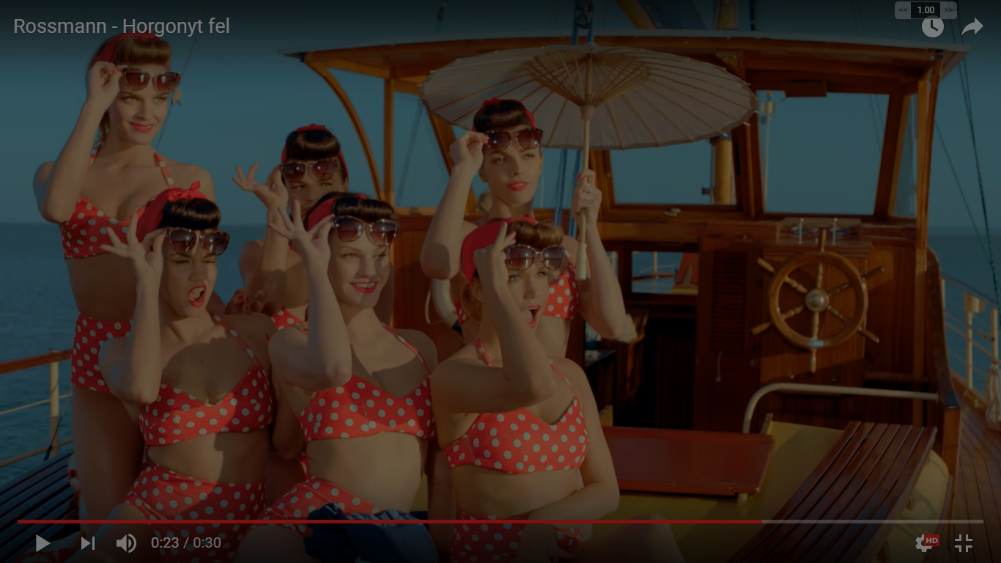
Conclusions
December effect is strongest for stores that do regular promotions
More people go to Rossmann on Mondays during active promotions
Stores that have customers on Sunday do not need to regularly promote
Active promotion does not have an effect on b, but starting regular actions after an opening do
Promotion

Slide 11
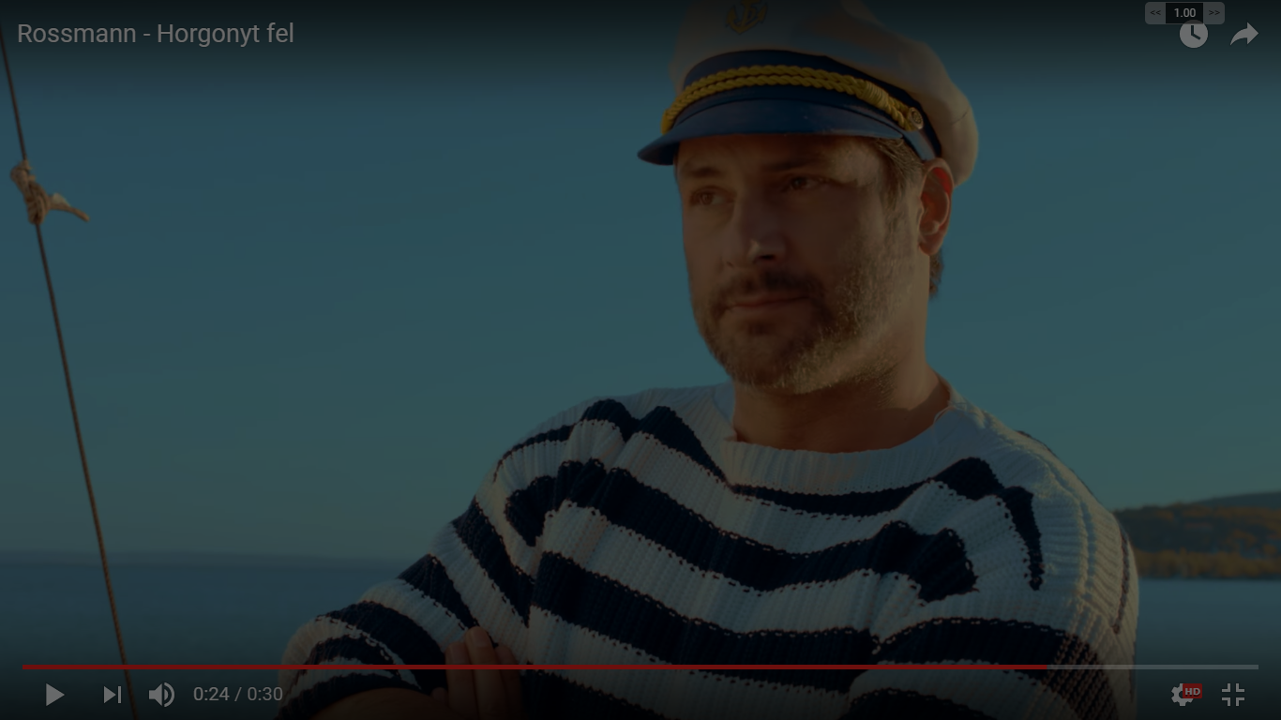
Conclusions
Different competition implies different promotion: Price race for strong competition and loyalty programs for others
Competition steals your customers, but those who return really like you
If you are in a plaza, you do massive promotion before your competition opens, most of the gain is lasting
Competition

Slide 12
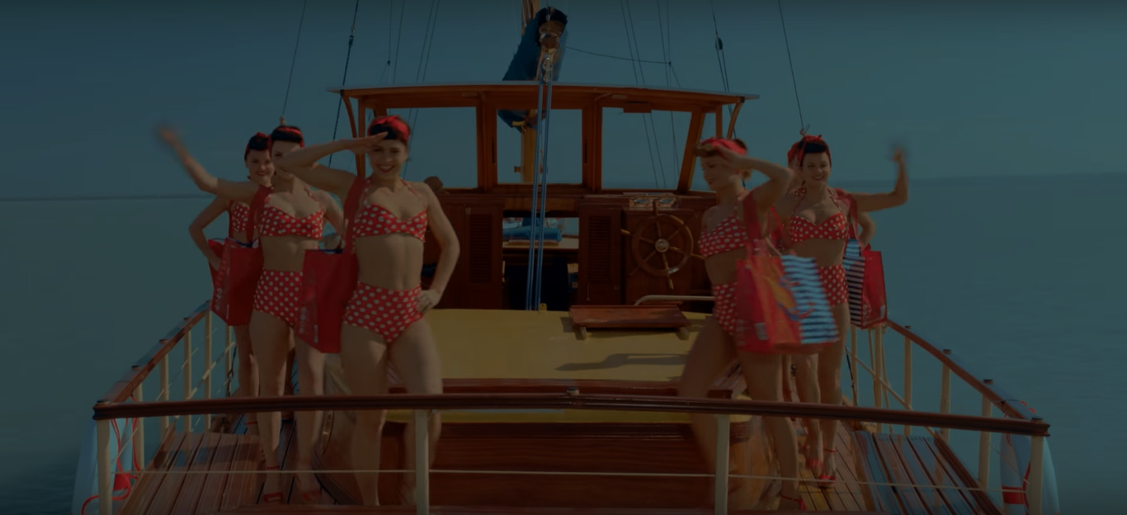
Kaggle Submission
GLM, Random Forest, NN and some feature engineering
R^2=0.76
Position: 1600/3300
Competition
Thank you for your attention

Slide 13
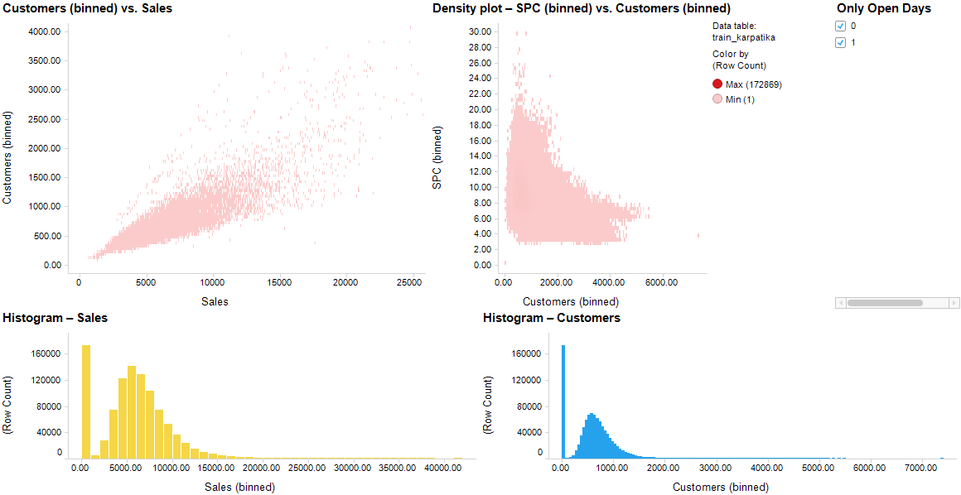
Overview

Slide 14
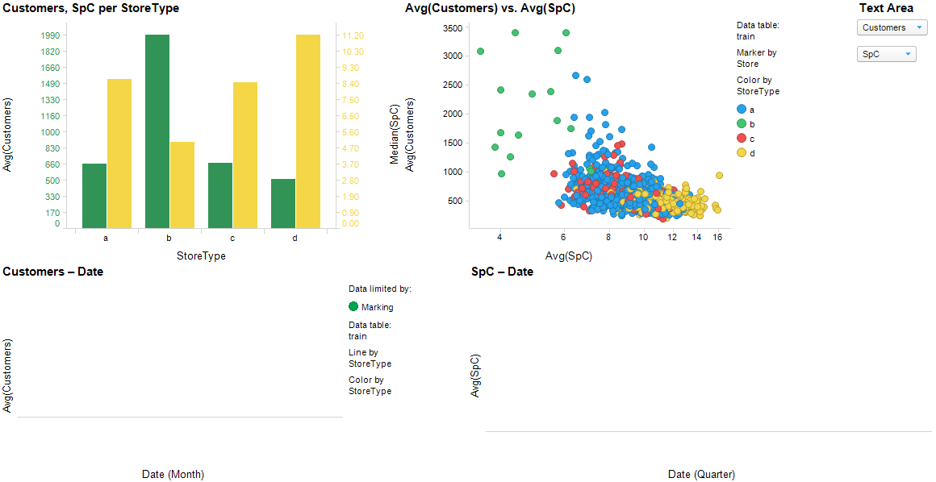
storeTypes

Slide 15
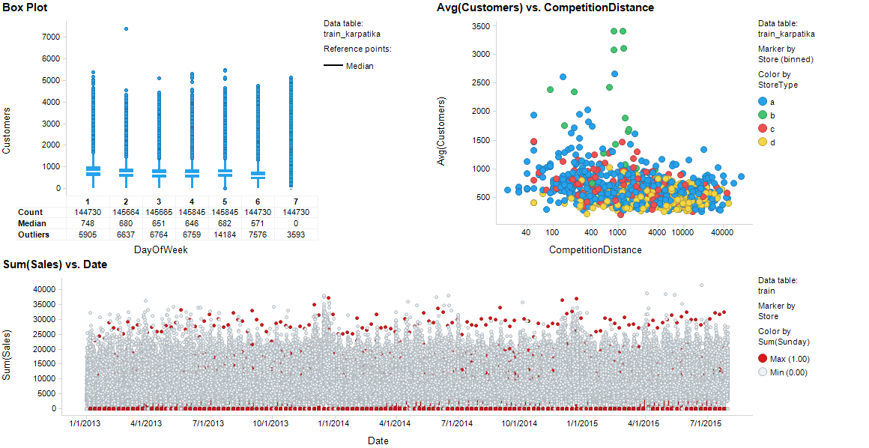
Sunday

Slide 16
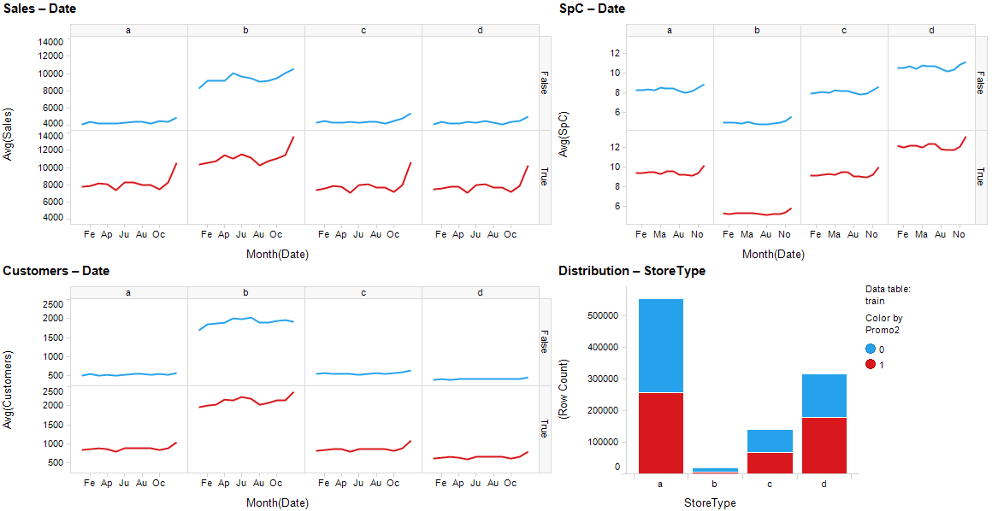
StoreTypesPromo

Slide 17
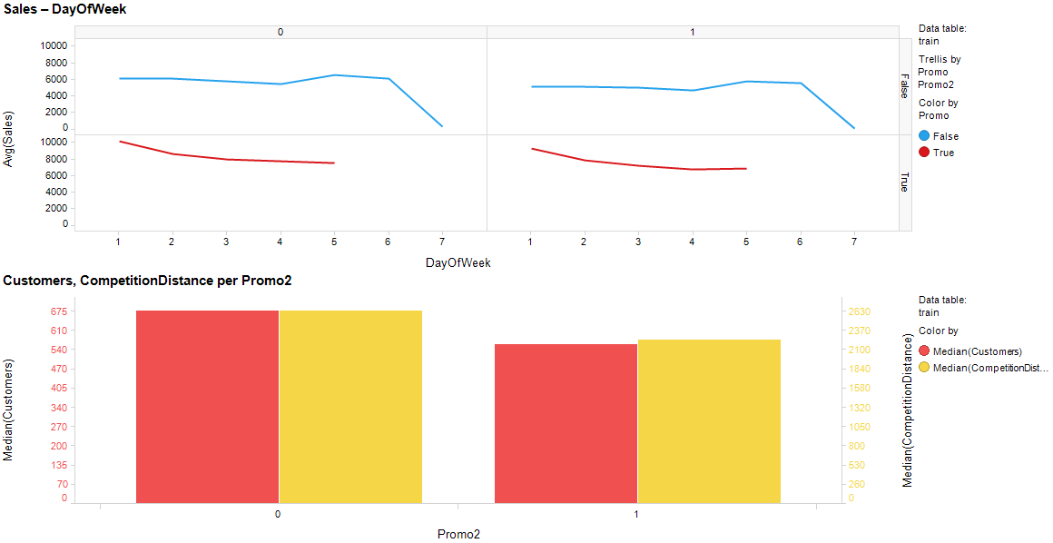
diffPromo

Slide 18
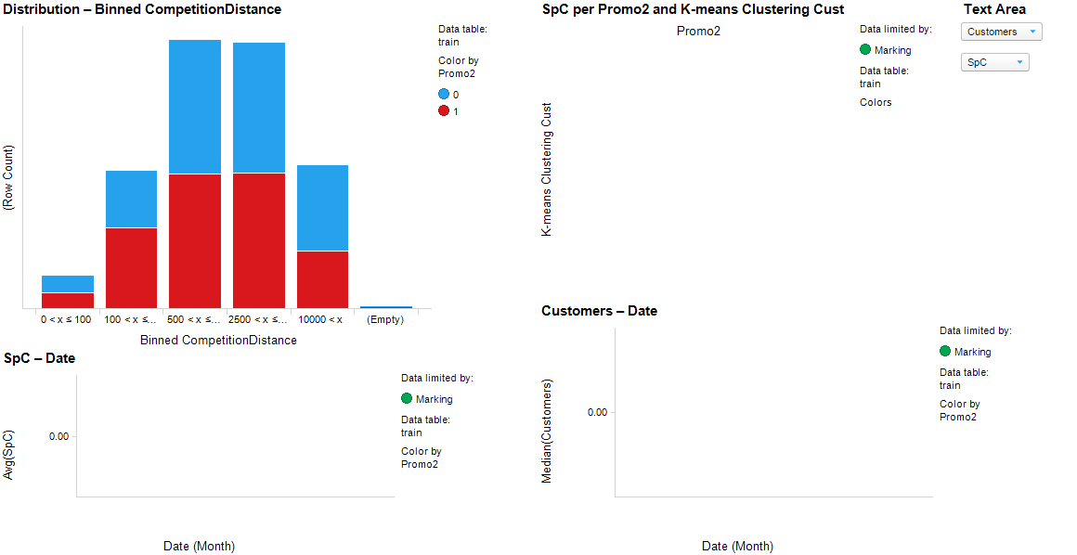
competititon

Slide 19
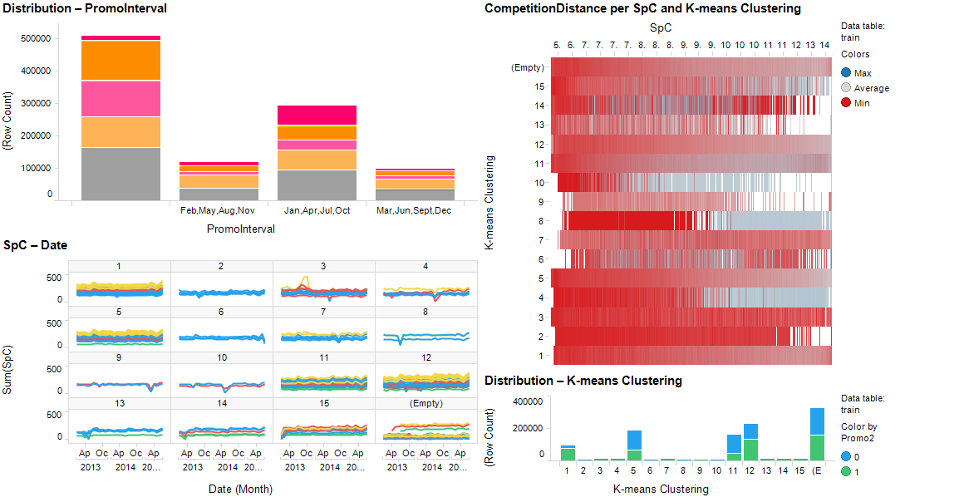
SpC

Slide 20
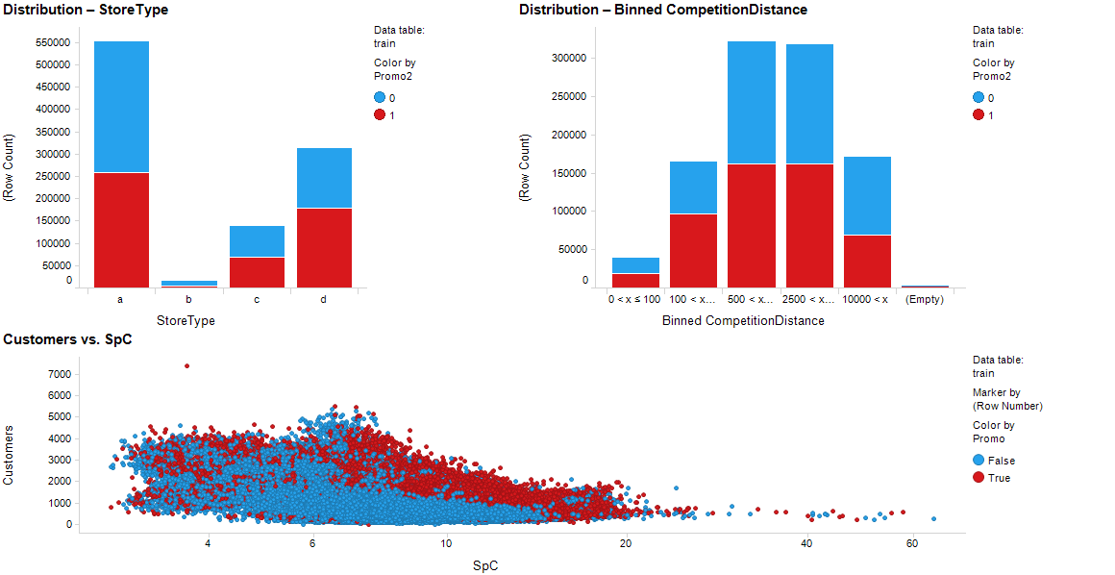
Promo1

Slide 21
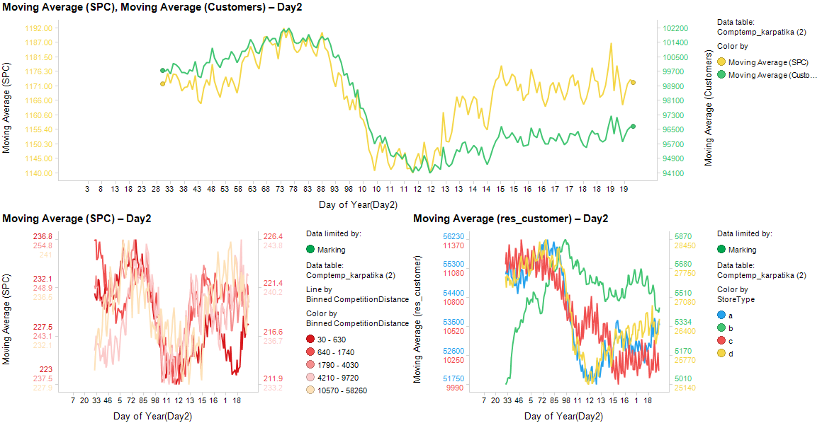
Competition

Slide 22
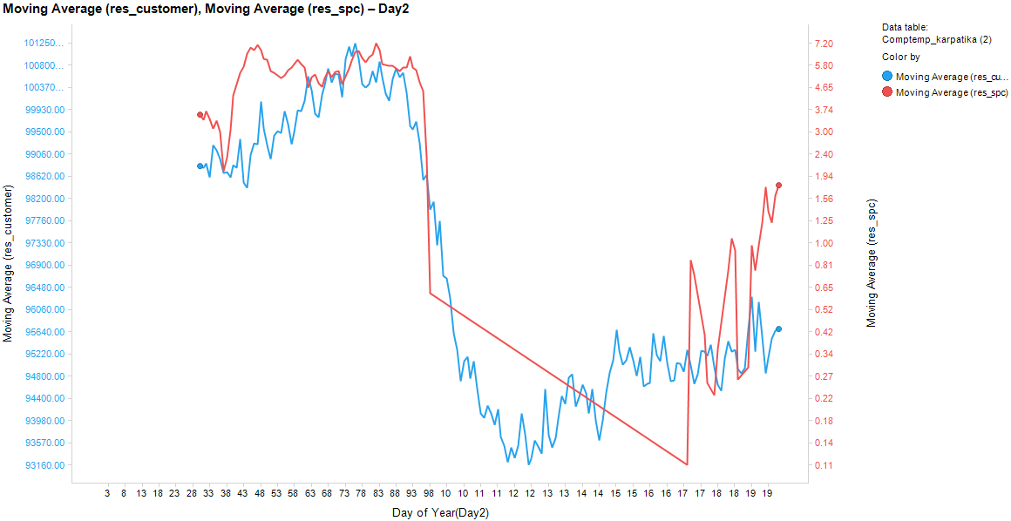
Competition (2)

Slide 23
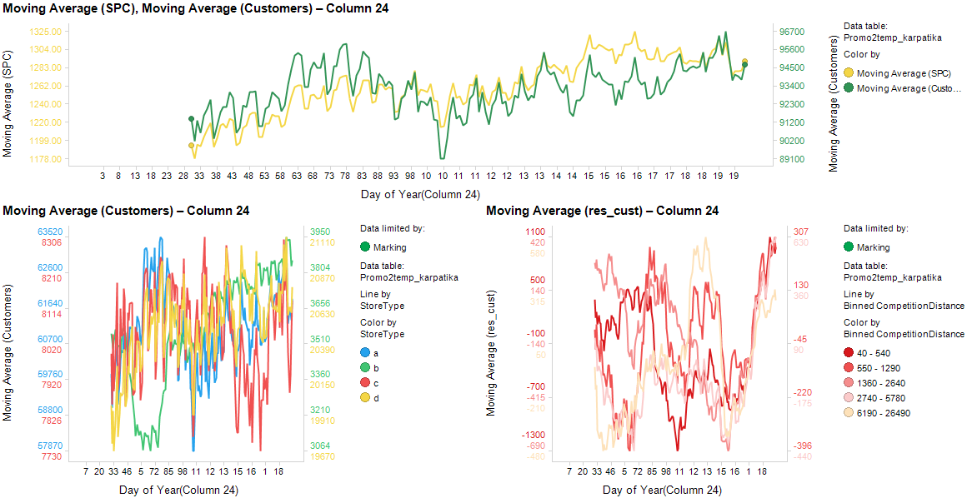
Promo2Start

Slide 24
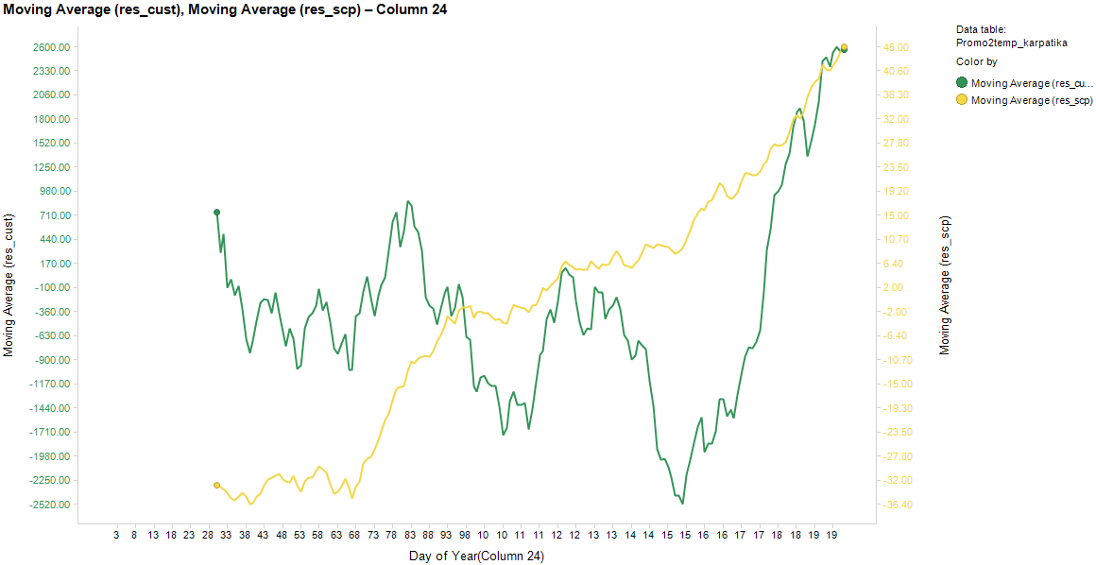
Promo2Start2

